Slide 1
Doggie Date Team
Team Members:
Vyoma Desai
Affan Charolia
Ali Alyami

Slide 2
Introduction
A lot of people have been affected by this pandemic and have to spend a lot of time at home. Most of the people have someone to accompany them, and among them there are some; who are more lucky; to have their pets give them company. Pets are adorable creatures, who help you lighten your mood and bring joy on your face. They are amazing companions and especially pets like dog. Still people need human friends and with the world somewhat starting to recover from this and people starting to go out and move around they can make new friends with help of their dogs.

Slide 3
Proposed System
The project is based on the goals, for people to have a smooth transition from being indoors to getting back out again and having social interactions. For this we are proposing a system which will help people find companions based on their location and their preference of the person or the dog and its breed. This will help people to socialize again and get back to their normal lives.

Slide 4
Dataset
For this project a temporary dataset was collected which had attributes like:
Dog Name
Dog Age
Dog Gender
Dog Breed
Owners Name
Owner Age
Owner Gender
City
State
Zip-code
Number of Dogs Owned by single individual

Slide 5
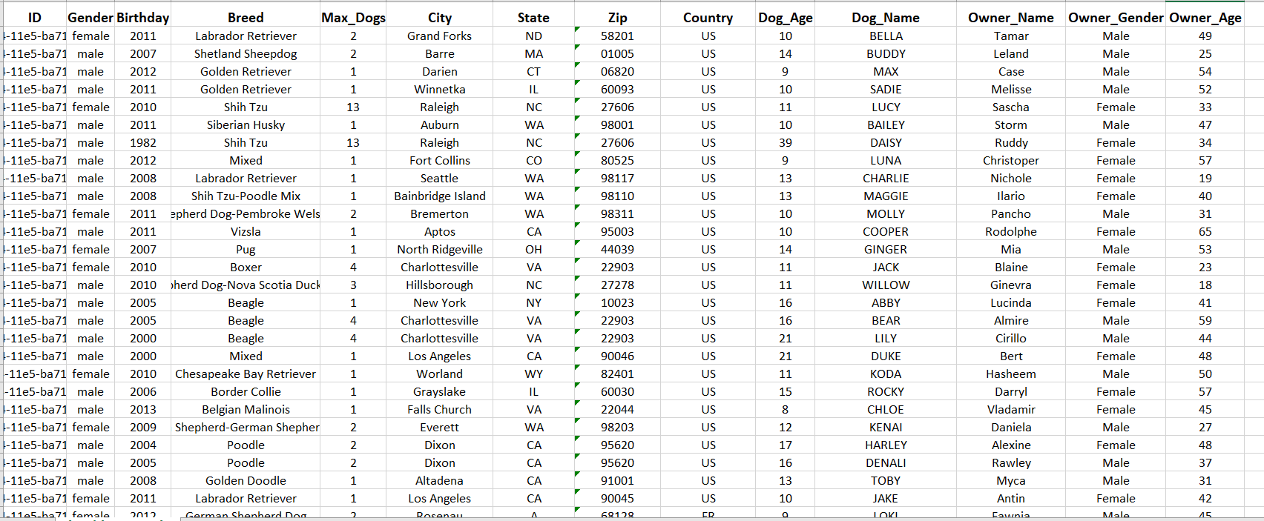
Dataset

Slide 6
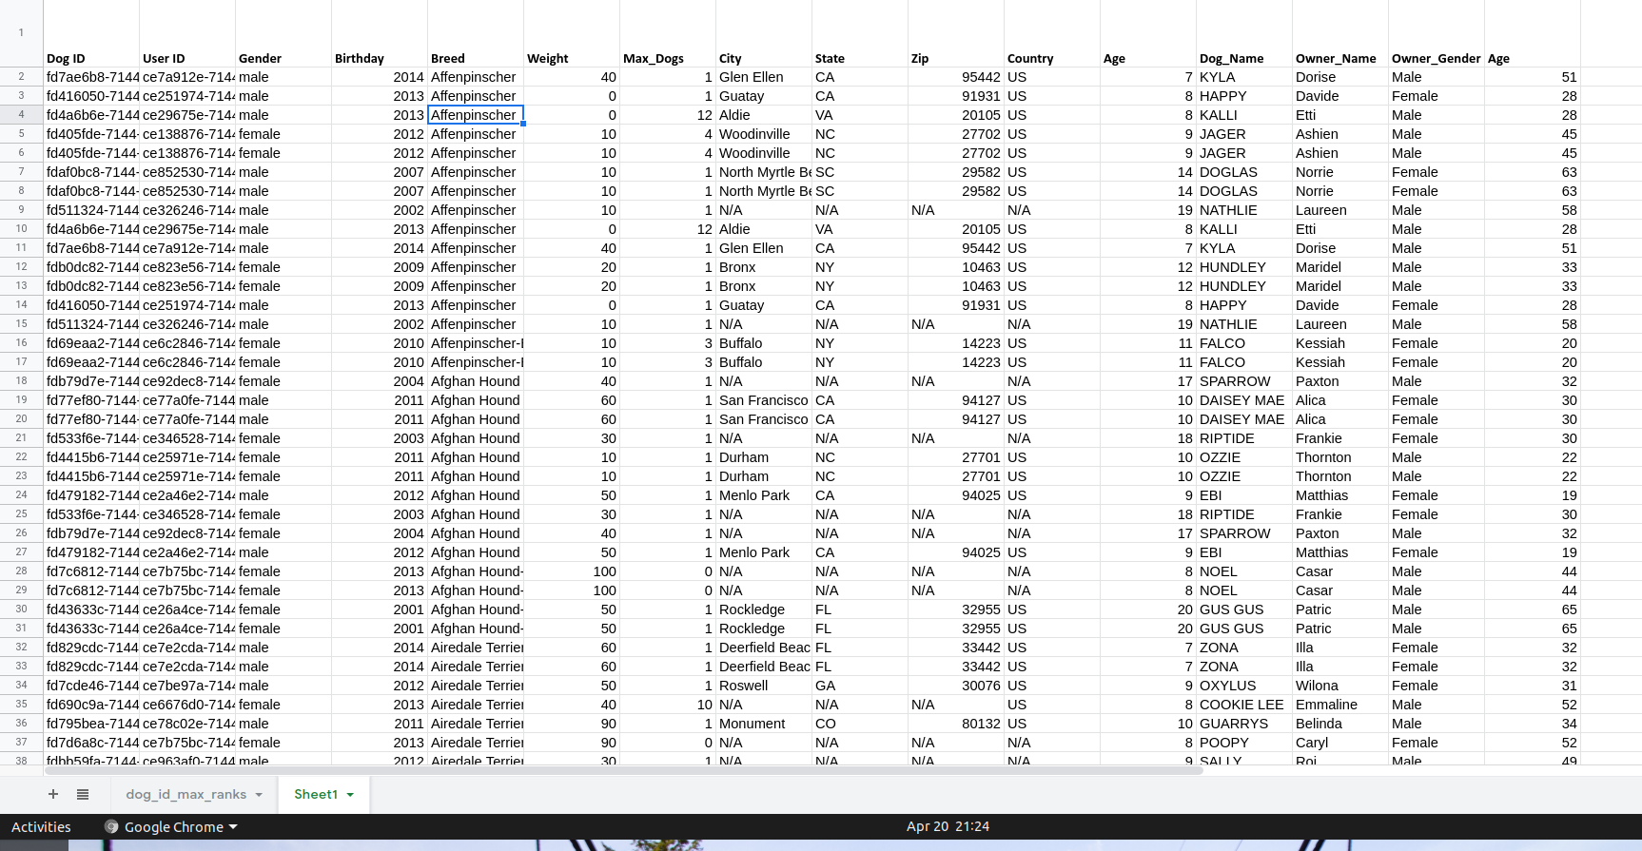
Output Query Clustered By Breeds

Slide 7
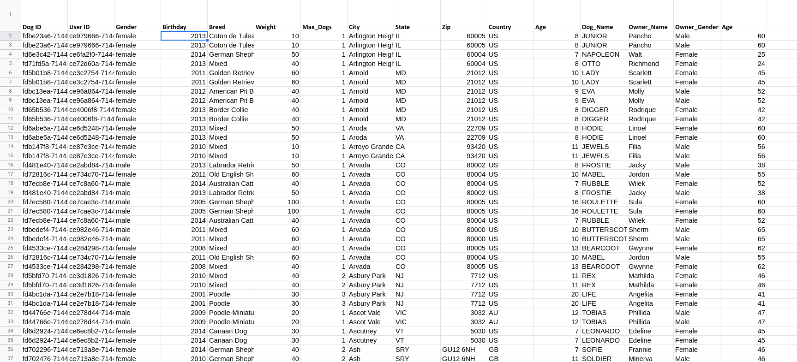
Output Query Clustered By City

Slide 8
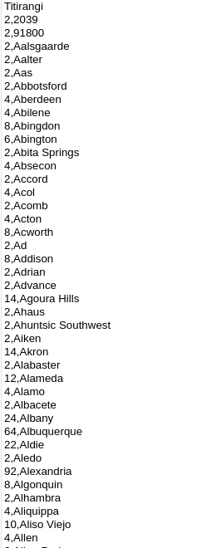
Dogs Count by City

Slide 9
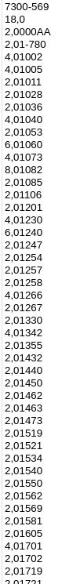
Dogs Count Based on Zip Code

Slide 10
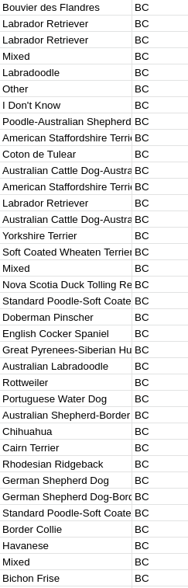
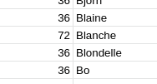
Group By Owner Name
Order By State

Slide 11
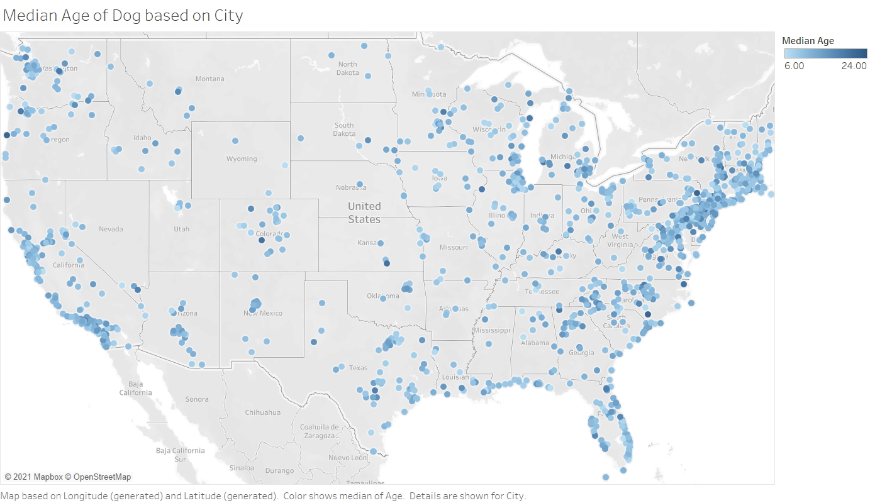
Visual Representations

Slide 12
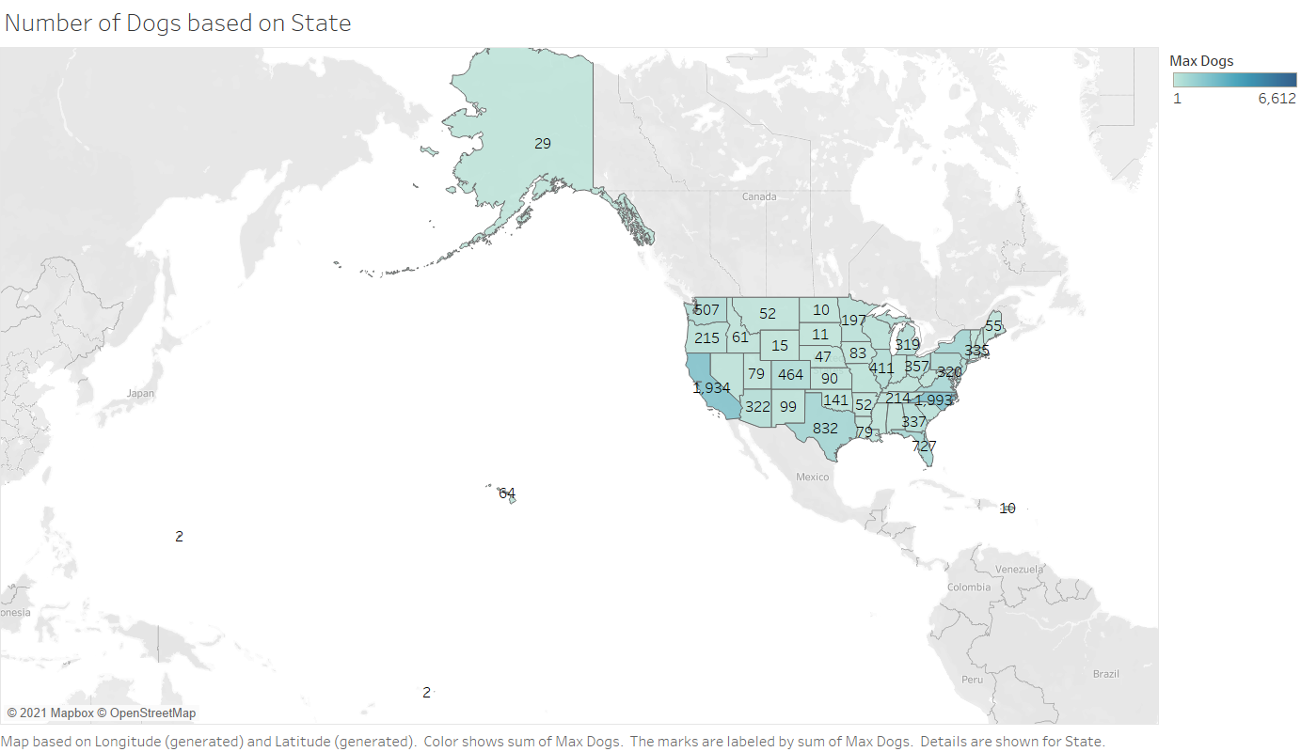
Visual Representations

Slide 13
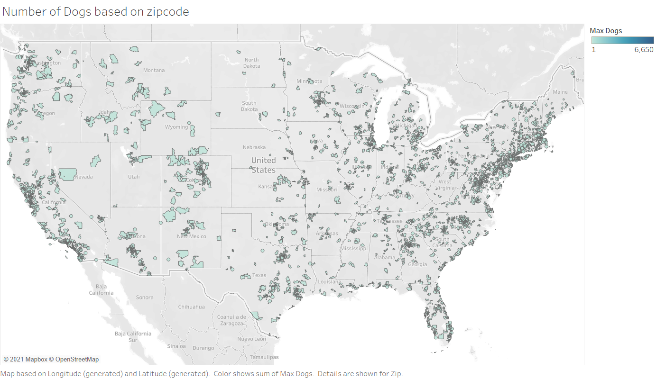
Visual Representations

Slide 14
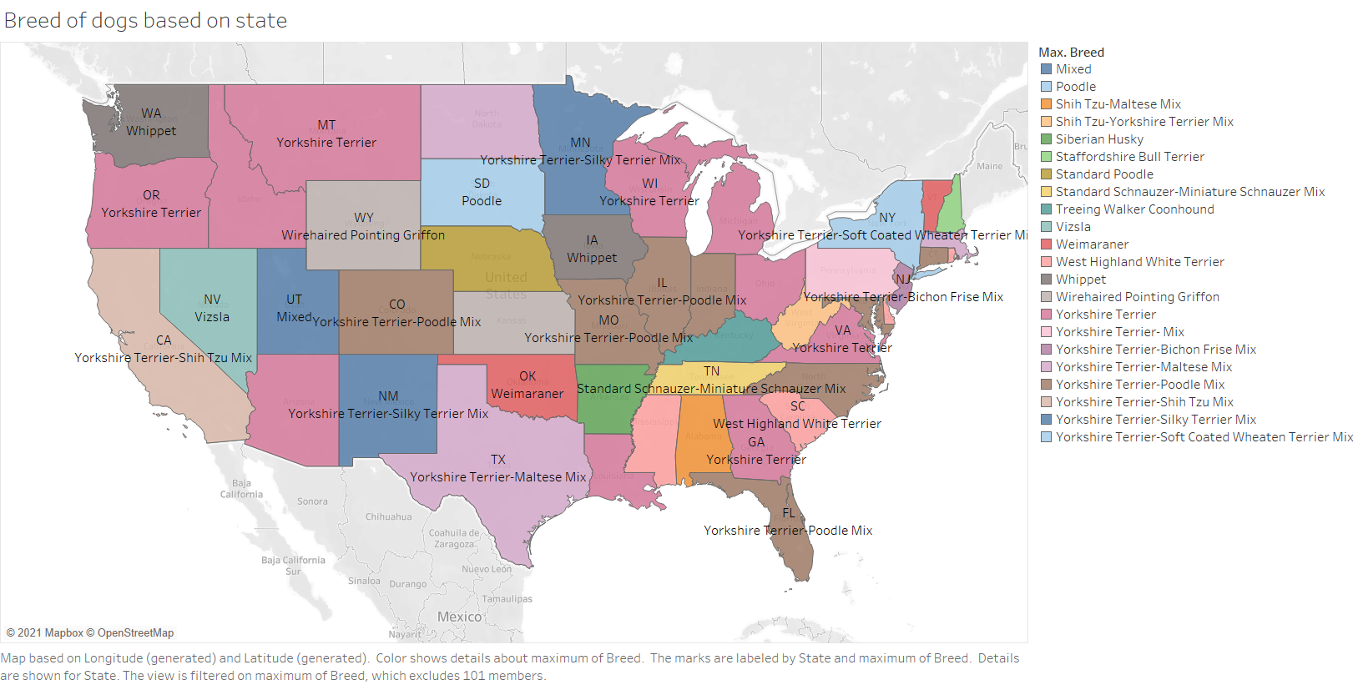
Visual Representations

Slide 15
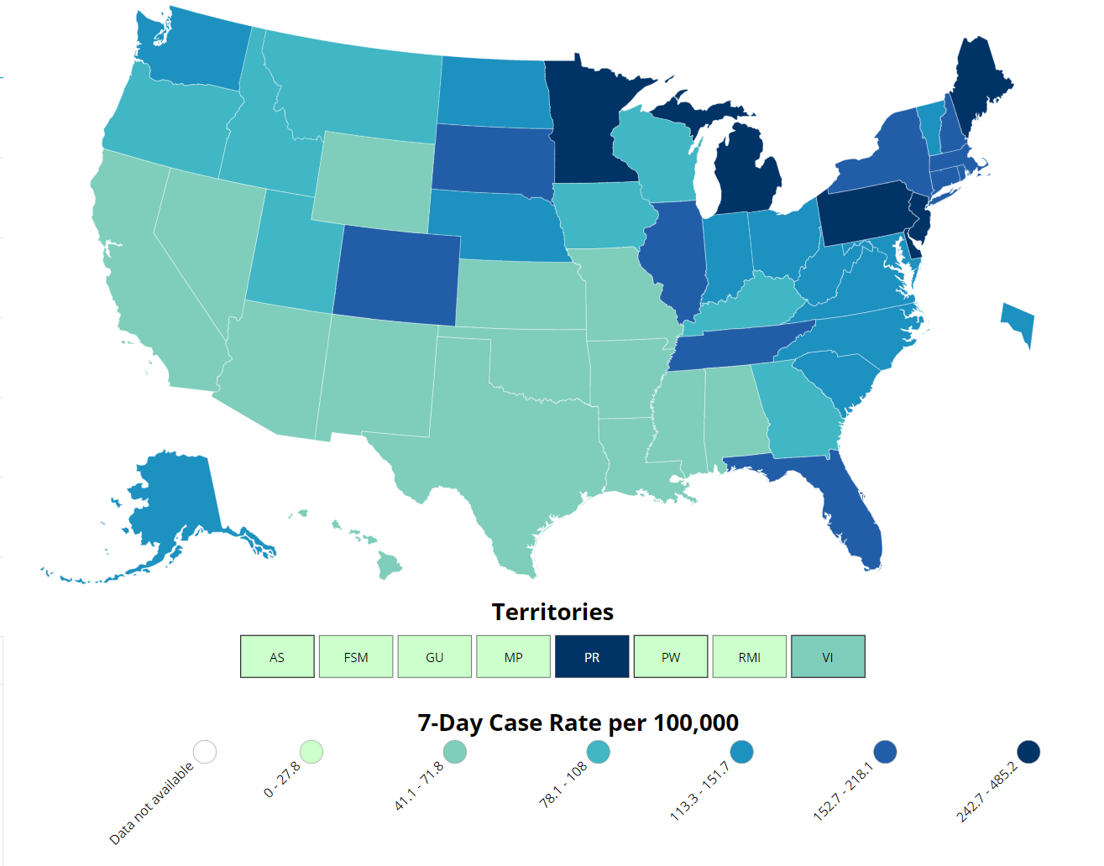
Visual Representations

